Slide 1

Team Name : Team Grooming
Team Leader Name : Charan Sai Pathuri Team Members names: Raajarapu Suswin, Boligorla Lokesh, Kondapally Simhadri, Martha Ushasree
Problem Statement : Design a personalized AI career advisor that maps skills, recommends career paths, and prepares students for the evolving job market.

Slide 2

Brief about the prototype: The prototype of SysBot – AI Career Studio is a lightweight, cloud-based web application designed to demonstrate how AI can assist students and professionals in career planning and interview preparation. It integrates multiple features into a single platform, making it both user-friendly and impactful.
Key aspects of the prototype include:
Career Discovery Module: Users upload their resume or enter their skills, and the system analyzes the input using AI to suggest suitable career paths along with detailed learning roadmaps.
Chat Interview Simulation: A text-based chatbot conducts mock interviews, asking role-specific questions and providing personalized feedback to improve communication and problem-solving skills.
Voice Interview Simulation: A voice-enabled mock interviewer where users can speak their responses, and the AI interacts in real-time through both text and synthesized voice for a realistic experience.
The prototype is built using a modern tech stack:
Frontend: React for the multi-tab interface (Career Discovery, Chat Interview, Voice Interview).
Backend: Vercel serverless API functions for scalable and fast performance.
AI Engine: Google Gemini API for intelligent text generation.
Voice Features: Web Speech API (Speech-to-Text) and Speech Synthesis API (Text-to-Speech).
Deployment: Entire system hosted on Vercel, making it lightweight, cloud-native, and easy to access.
This prototype validates the feasibility of an AI-powered career companion by combining career recommendations, interview practice, and skill development guidance into a single integrated solution.

Slide 3
Opportunity should be able to explain the following: 1. How different is it from any of the other existing solutions? Unlike traditional career counseling platforms or standalone interview apps, SysBot integrates career discovery, personalized learning roadmaps, and both chat- and voice-based interview simulations into one unified platform. It is free, always accessible, and AI-driven, making it more scalable and cost-effective than human-led career services.
2. How will it be able to solve the problem? SysBot addresses the gap by:
Analyzing a user’s resume or skills to suggest relevant career paths.
Providing structured learning roadmaps to bridge skill gaps.
Offering realistic interview practice (chat + voice) with instant AI feedback. This holistic approach ensures users are not just guided but also trained to succeed.
3. USP (Unique Selling Proposition) of the proposed solution
All-in-One AI Career Companion: Combines career counseling, skill development, and interview preparation in a single platform.
Free, Scalable, and Privacy-Focused: No hidden costs, works entirely online, and ensures data security.
Realistic Interview Simulation: Offers both chat- and voice-based practice, something most competitors lack.

Slide 4
List of Features Offered by the Solution Features Offered by SysBot – AI Career Studio
Career Discovery
Upload resume or enter skills to receive personalized career recommendations.
Generates detailed learning roadmaps for skill-building and transitions.
Chat-Based Mock Interviews
AI-powered text interview practice tailored to user’s target role.
Provides instant feedback on responses.
Voice-Based Mock Interviews
Realistic spoken interview simulation using Speech-to-Text and Text-to-Speech.
AI interviewer asks follow-up questions for an authentic experience.
Personalized Guidance
Matches skills to relevant career paths.
Suggests free learning resources and tools.
24/7 Availability
Always accessible, cloud-hosted platform.
Free to use, with no hidden costs.
Privacy-Focused
Secure handling of personal data.
No external sharing of uploaded resumes or skills.

Slide 5
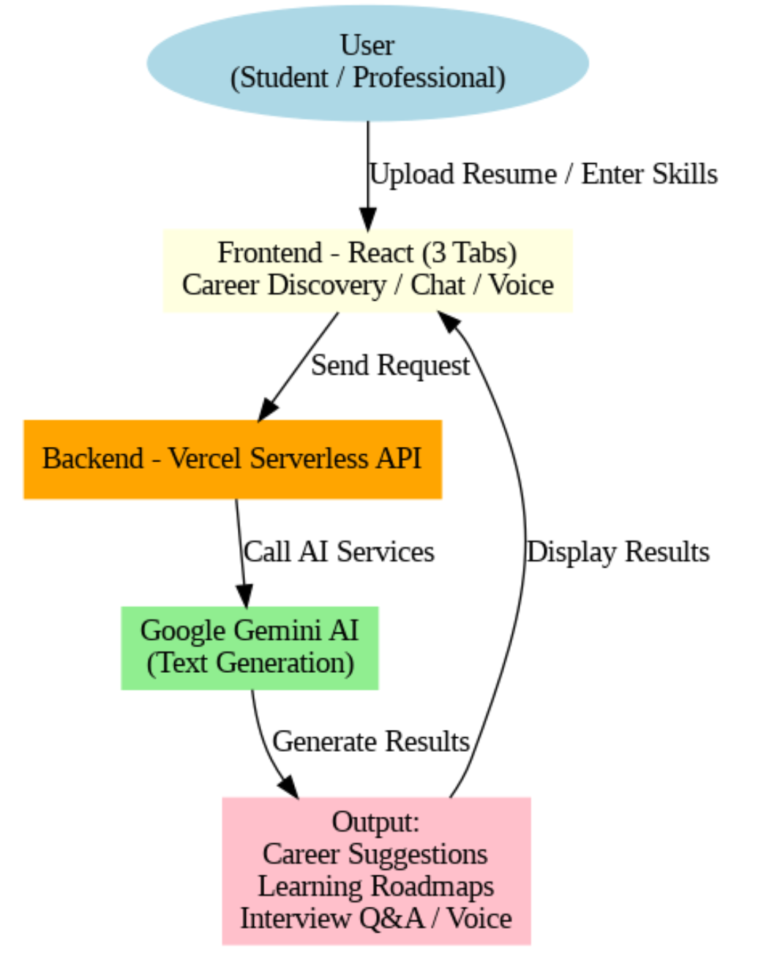
Process flow diagram or Use-case diagram
Add a flow diagram or a use case diagram or an architecture diagram.

Slide 6
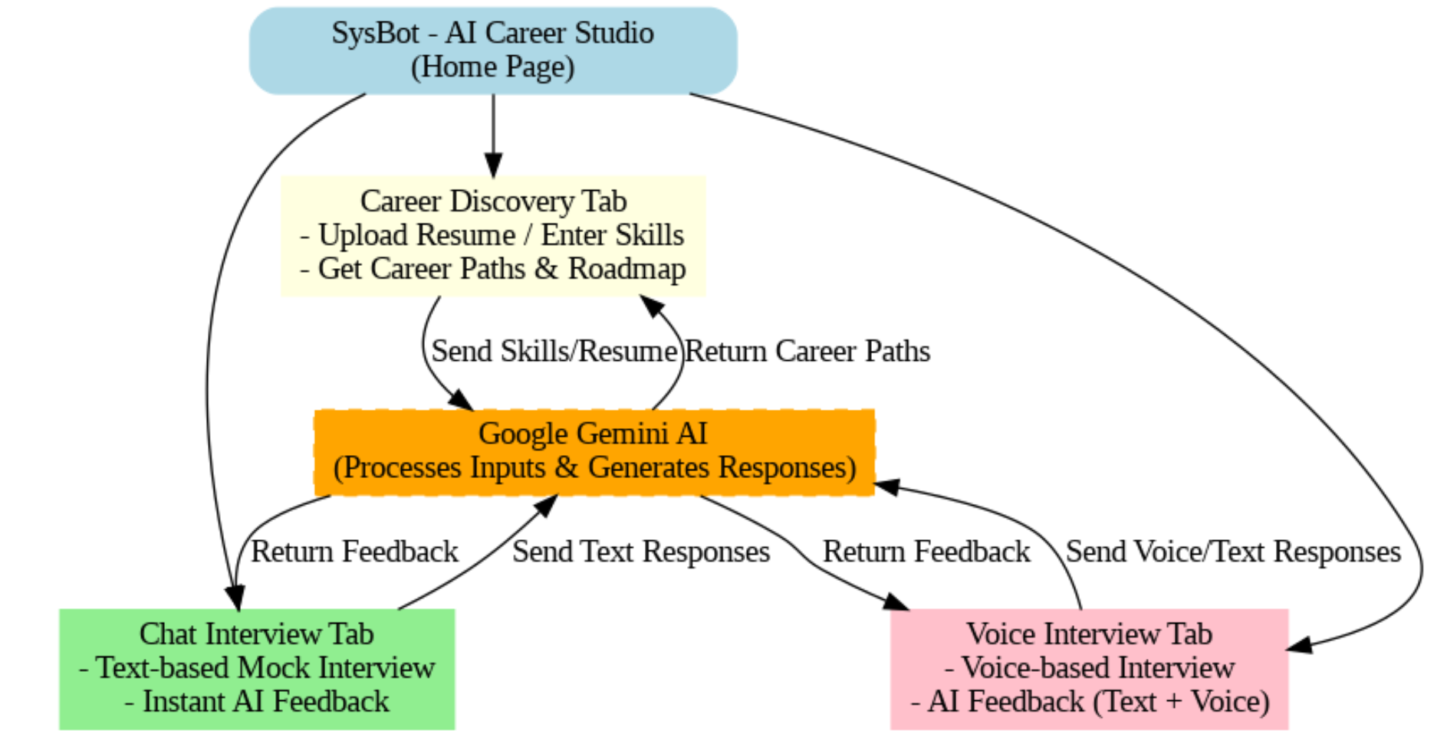
Wireframes/Mock diagrams of the proposed solution (optional)

Slide 7
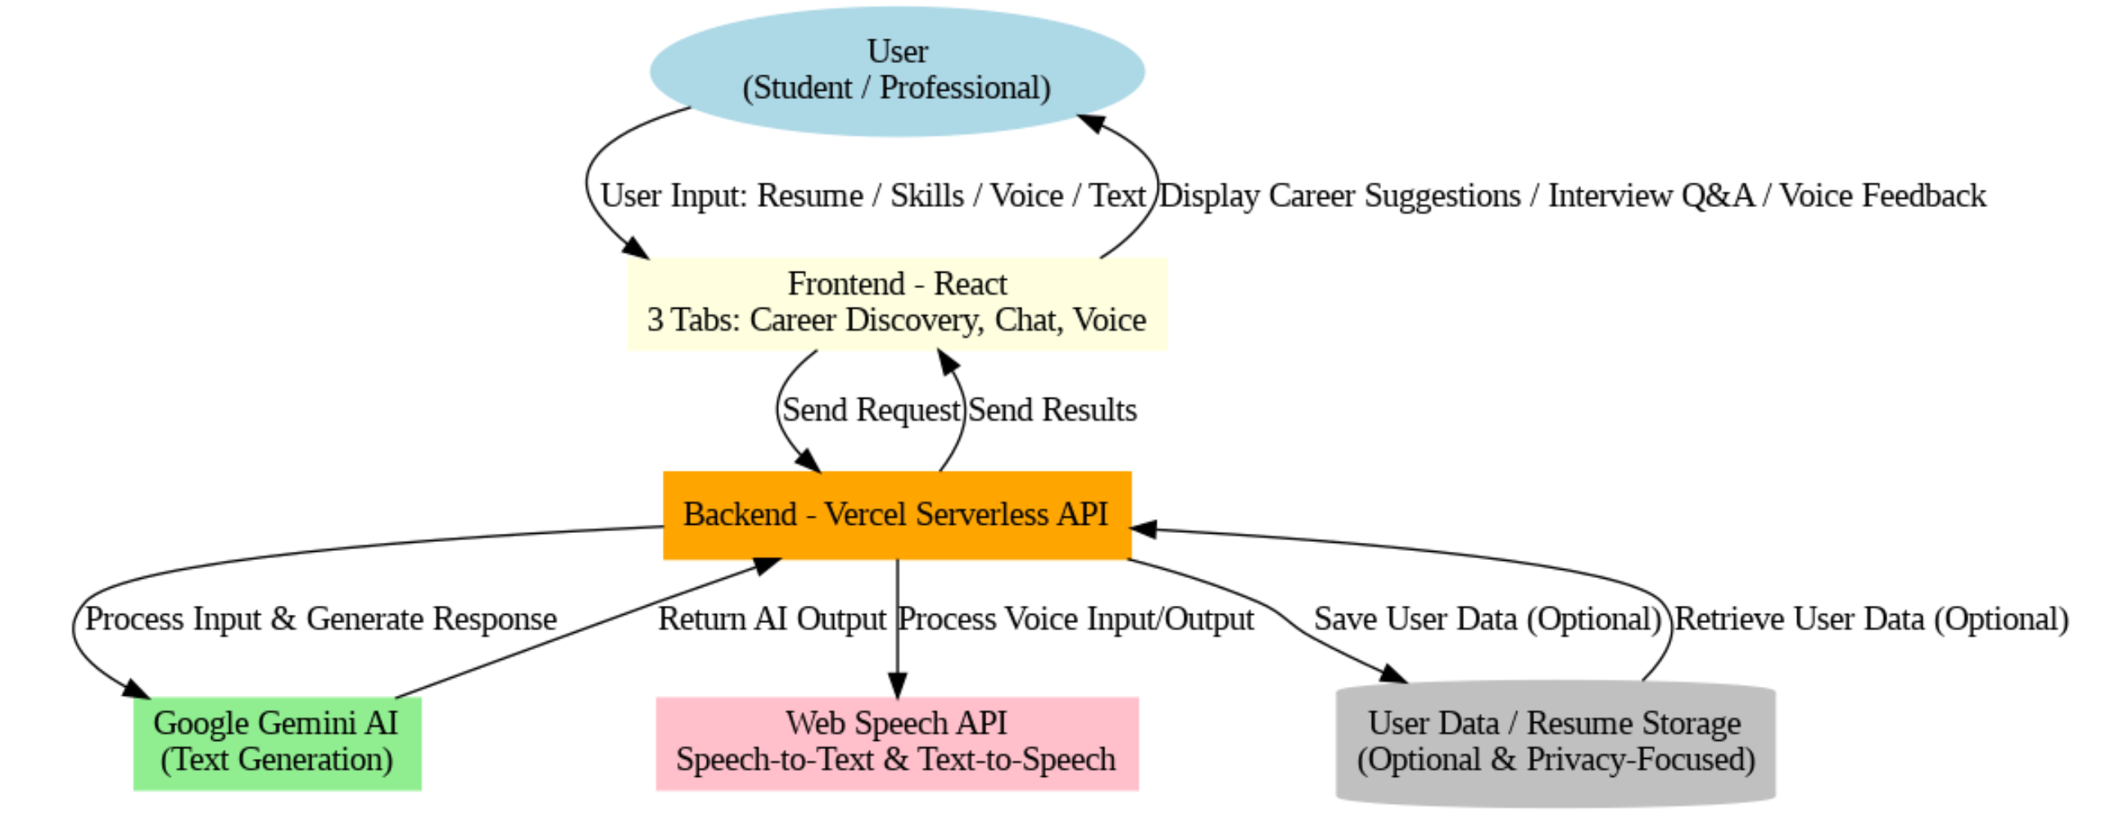
Architecture diagram of the proposed solution

Slide 8
Technologies to be used in the solution: 1. Frontend
React.js: Builds a responsive, interactive multi-tab interface (Career Discovery, Chat Interview, Voice Interview).
2. Backend
Vercel Serverless Functions: Lightweight, scalable API backend to handle user requests and communicate with AI services.
3. AI Engine
Google Gemini API: Generates career suggestions, learning roadmaps, and interview Q&A using advanced text generation.
4. Voice Processing
Web Speech API: Converts user voice input into text (Speech-to-Text).
Speech Synthesis API: Converts AI responses into voice output (Text-to-Speech) for realistic voice interviews.
5. Deployment / Hosting
Vercel Cloud: Full cloud deployment of frontend and backend, ensuring 24/7 availability and fast access.
6. Data / Storage (Optional)
Privacy-focused storage: Stores user resume/skills securely if needed for personalized recommendations.

Slide 9
Estimated implementation cost (optional):
Component | Technology / Service | Estimated Cost | Notes
Frontend | React.js | Free | Open-source, no hosting cost if deployed on Vercel Free tier
Backend | Vercel Serverless Functions | Free / $20+ | Free tier sufficient for hackathon prototype
AI Engine | Google Gemini API | Free / Pay-as-you-go | Limited requests may be free; pay-as-you-go for extended usage
Voice Services | Web Speech API + Speech Synthesis API | Free | Browser-native APIs, no cost
Hosting / Deployment | Vercel Cloud | Free | Free tier supports cloud deployment and 24/7 access
Storage (Optional) | Privacy-focused storage | Free / Low | Optional for demo; can use free DB or local storage

Slide 10
Add as per the requirements for the hackathon: We Need Mentorship regarding this Project.

Slide 11


